Slide 1
Retail Sales Prediction
Nachiket Dattatraya Dixit
Email: erdnachiket@gmail.com
Course: Advance AI and ML(LBDSC25082023)

Slide 2
Content
Problem Statement
Introduction (Retail Sales Prediction)
Data Summary
Project Approach
Exploratory Data Analysis
Outlier Detection
Modeling
Baseline Model: Decision Tree
Bagging Regressor
Random Forest Classifier
Hyperparameter Tunning
Feature Importance
Sales Prediction
Conclusion and Recommendation
References

Slide 3
Problem Statement
XYZ operates over 3,000 drug stores in 7 countries. XYZ store managers are currently tasked with predicting their daily sales up to six weeks in advance. Store sales are influenced by many factors, including promotions, competition, school, and state holidays, seasonality, and locality. With thousands of individual managers predicting sales based on their unique circumstances, the accuracy of results can be quite varied.
You are provided with historical sales data for 1,115 XYZ stores. The task is to forecast the "Sales" column for the test set. Note that some stores in the dataset were temporarily closed for refurbishment.

Slide 4
Introduction (Retail Sales Prediction)
Sales forecasting involves predicting the demand or sales of a specific product over a defined time frame.
Interest in products fluctuates over time, making it crucial for businesses to accurately gauge customer interest and future product demand for monetary growth.
Sales forecasting is the process of predicting the demand for or sales of a specific product over a defined period. Accurate sales forecasts require high-quality datasets, as they rely on historical records, trends, and patterns observed in a store's sales data, which can vary due to numerous factors. From a business perspective, consistent sales forecasting is essential for enhancing operations and decision-making.

Slide 5
Data Summary - 1
Id - an Id that represents a (Store, Date) duple within the set
Store - a unique Id for each store
Sales - the turnover for any given day (Dependent Variable)
Customers - the number of customers on a given day
Open - an indicator for whether the store was open: 0 = closed, 1 = open
State Holiday - indicates a state holiday. Normally all stores, with few exceptions, are closed on state holidays. Note that all schools are closed on public holidays and weekends. a = public holiday, b = Easter holiday, c = Christmas, 0 = None
School Holiday - indicates if the (Store) was affected by the closure of public schools
Store Type - differentiates between 4 different store models: a, b, c, d

Slide 6
Data Summary - 2
Assortment - describes an assortment level: a = basic, b = extra, c = extended. An assortment strategy in retailing involves the number and type of products that stores display for purchase by consumers.
Competition Distance – the distance in meters to the nearest competitor store
Competition Open Since[Month/Year] - gives the approximate year and month of the time the nearest competitor was opened
Promo - indicates whether a store is running a promo on that day
Promo2 - Promo2 is a continuing and consecutive promotion for some stores: 0
= store is not participating, 1 = store is participating
Promo2 Since[Year/Week] - describes the year and calendar week when the store started participating in Promo2
Promo Interval - describes the consecutive intervals Promo2 is started, naming the months the promotion is started anew. E.g. "Feb, May, Aug, Nov" means each round starts in February, May, August, and November of any given year for that store.

Slide 7
Project Approach
Problem Statement
Data collection and Preprocessing
Exploratory Data Analysis
Feature Selection and Outlier Detection
Modelling
Model performance and evaluation
Sales Prediction
Recommendation and Conclusion

Slide 8
Exploratory Data Analysis
Hypothesis: -
The "DayOfWeek" feature, with values ranging from 1 to 7 representing each day of the week, suggests that there is likely a day off, possibly Sunday, when stores are closed, resulting in lower overall sales.
There should be a positive correlation between the number of customers and sales.
The type of store and its assortment strategy may impact sales, with premium high-quality products likely generating more revenue.
Promotions are expected to have a positive correlation with sales.
Stores that are closed for refurbishment will generate zero revenue during that period.
Sales patterns are likely to exhibit seasonality, with higher sales occurring before holidays.
Promo leads to more sales.

Slide 9
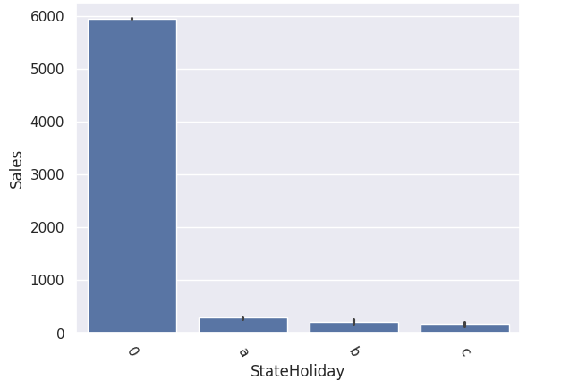
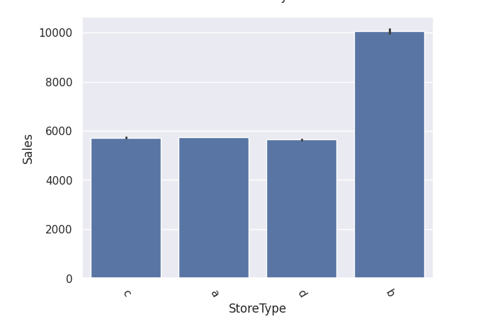
Exploratory Data Analysis
A bar plot depicts a central tendency estimate of a numeric variable using the height of each bar. In this case, it is evident that Store Type B consistently achieved the highest sales on average.
There appears to be a distinguishing factor associated with this particular store type.
Furthermore, Store Types A, C, and D exclusively offer assortment levels A and C, whereas Store Type B provides all three assortment strategies.

Slide 10
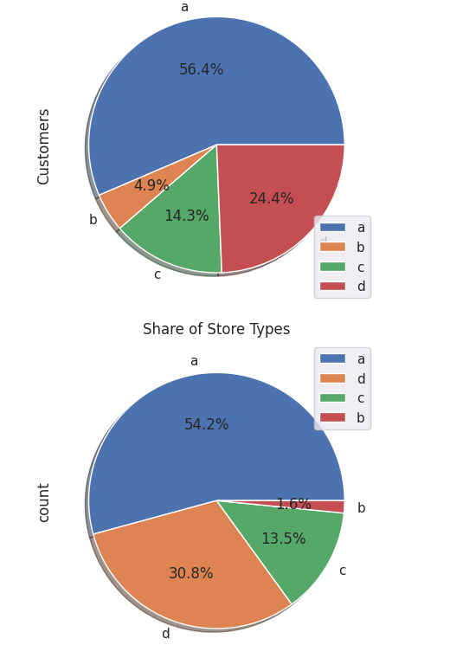
Pie Chart Distribution
Based on these findings, Store Types 'B' and 'D' appear to present significant opportunities:
Store Type 'B' has a higher number of customers per store, while Store Type 'D' shows higher sales per customer. In contrast, Store Types 'A' and 'C' exhibit similar sales metrics per customer and per store, benefiting from their greater representation in the dataset, which contributes to their overall revenue figures.
Despite their smaller number, Store Type 'B' notably outperforms others in average sales.

Slide 11
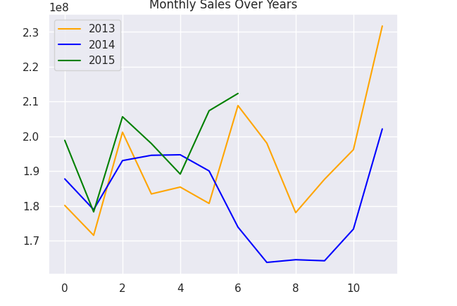
Monthly Sales Over Year
In 2013, there was a notable surge in sales, and a similar pattern emerged in 2014. Despite having data for only six months in 2015, analysis suggests that sales are likely to continue increasing in the months ahead.

Slide 12
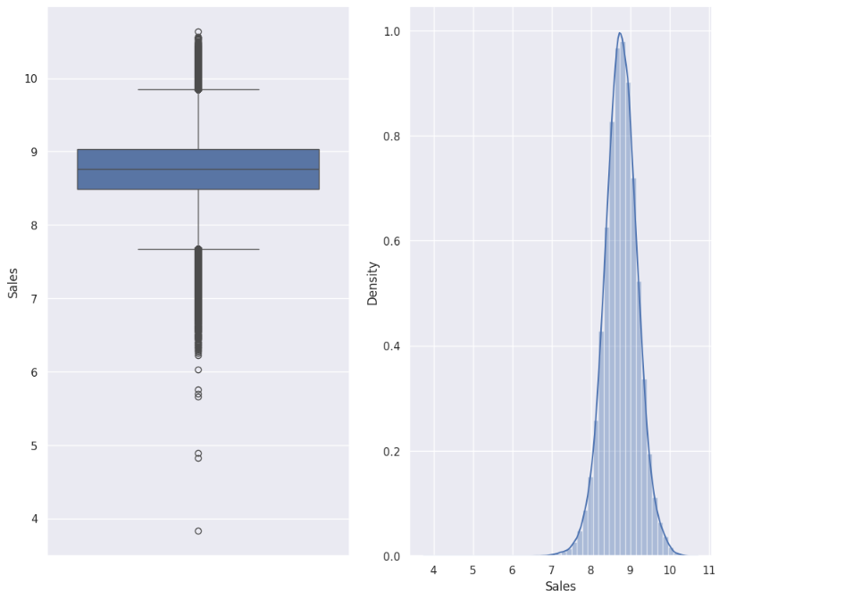
Outlier Detection
A data point that dramatically deviates from other observations is called an outlier in statistics. Although outliers can happen by accident in any distribution, they frequently point to either measurement error or a heavy-tailed population distribution.
Using z-scores for outlier detection provides a standardized way to identify extreme values in your dataset based on their deviation from the mean, using the assumption that the data is normally distributed.
In statistics, an outlier is a data point that differs significantly from other observations. Outliers can occur by chance in any distribution, but they often indicate either measurement error or that the population has a heavy-tailed distribution.

Slide 13
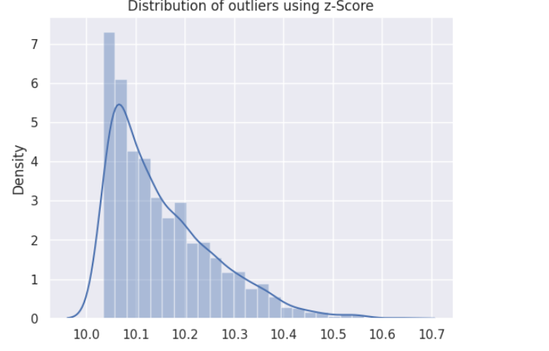
Distribution of Outliers using z-score
Z-score threshold is set 3.
Distribution of datapoints after 10.2 decreases ,So, 10.2 is upper limit for outliers.

Slide 14
Modeling
The issue statement, the desired result, the kind and volume of the data, the amount of processing time available, the number of features, and the observations in the data are just a few of the variables that affect which approach to apply.
This analysis cannot presume a linear relationship since the dataset it uses has a multivariate time series association with sales. In a basic linear regression, this type of dataset's patterns—such as peak days and holiday seasons—would probably be regarded as anomalies.
30% continuous features and 70% category features are present in X columns. Business wants a model that can be understood, and decision-based algorithms perform better when dealing with categorical data.

Slide 15
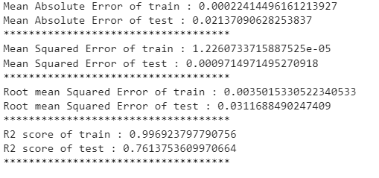
Baseline Model: Decision Tree Regression
The MAE on the training set is very low, indicating that the model's predictions are very close to the actual values on the training data. The higher MAE on the test set suggests that the model's predictions are not as accurate on unseen data, although it is still relatively low.
The test MSE should be different, the lower MSE on the testing set compared to the training set generally indicates better performance on the testing data.
The R2 score on the training set is very close to 1, indicating that the model explains almost all the variability in the training data. The lower R2 score on the test set suggests that the model does not generalize as well to new data, though an R2 score of 0.7613 still indicates a good fit on the test set.

Slide 16
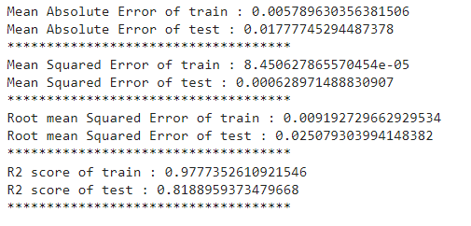
Bagging Regressor
The Bagging Regressor demonstrates strong performance with low error metrics and high R² scores on both the training and test sets. The observed overfitting, where the model fits the training data better than the test data, is typical for powerful ensemble methods. Despite this, the model generalizes well to new data, as evidenced by the high R² score and low error metrics on the test set. Overall, the Bagging Regressor is reliable and effective for making predictions on new, unseen data.

Slide 17
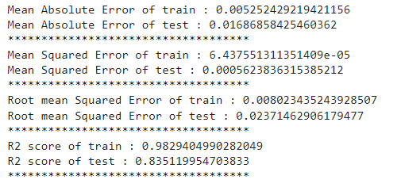
Random Forest Regressor
The high R² scores on both the training (98.29%) and test (83.51%) sets indicate that the model captures most of the variability in the data, particularly on the training set.
The Random Forest Regressor demonstrates strong performance with high accuracy and low error rates on both training and test datasets. The slight overfitting observed is typical for powerful models like Random Forests, but the model still generalizes well to new data, as evidenced by the relatively high R² score on the test set. This suggests that the model is reliable for making predictions on new, unseen data.

Slide 18
Hyperparameter Tunning
R2 score of train : 0.9829188638249261
R2 score of test : 0.8362660885676357
Percentage Increase in efficiency after tunning : 0.99%
This indicates that all the trends and patterns that could be captured by these models without overfitting were done and maximum level of performance achievable by the model was achieved.

Slide 19
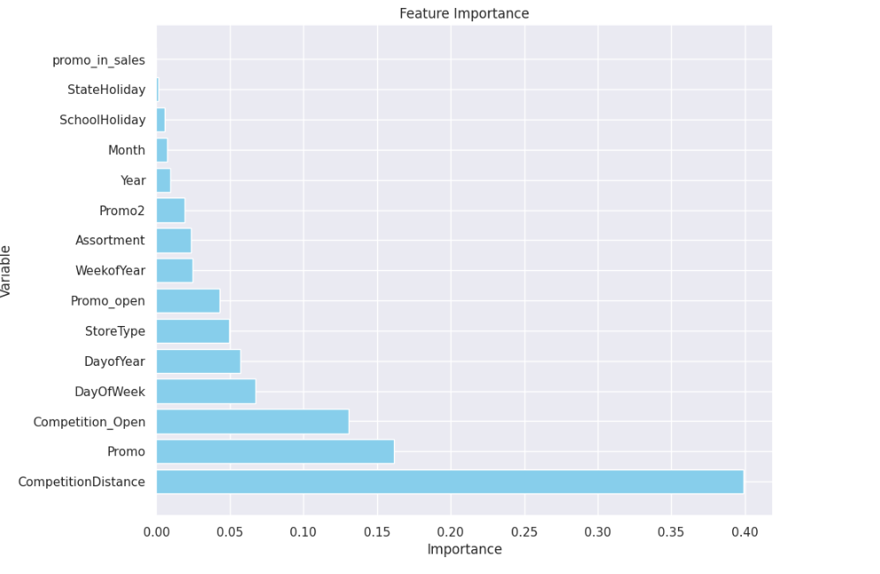
Feature Importance

Slide 20
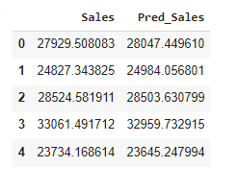
Sales Prediction
Given below latest 6 week sales prediction by model and its comparison with given data : (First 5 rows)

Slide 21
Conclusion and Recommendations
Sales forecasts are crucial for businesses to plan strategic initiatives and allocate resources effectively based on anticipated revenue over specific periods.
This analysis forecasts recent six-week sales for XYZ stores across Europe and compares model predictions with actual sales data.
Observations validate that Mondays typically show higher sales, likely due to stores being closed on Sundays, the day with the lowest sales.
The positive impact of promotions on customer traffic and sales is evident from the data.
Stores located closer to competitors, typically within 0 to 10 kilometers, tend to achieve higher sales compared to those farther away, indicating the influence of location on sales performance.
Despite being fewer in number, stores categorized as type B exhibit the highest average sales, attributed to their unique assortment offerings and Sunday opening hours.
Outliers in the dataset, often associated with type B stores or promotional activities, demonstrate justifiable sales behavior.
The Random Forest Tuned Model performed optimally, showing only a marginal 0.99% improvement over the basic Random Forest model, suggesting effective capture of sales trends without overfitting.
Recommendations include expanding promotional activities across more stores to boost sales.
Increasing the number of type B stores is advisable, given their higher sales performance and unique assortment offerings.
Recognizing the presence of seasonality, stores should leverage promotional strategies during holiday seasons to maximize sales opportunities.

Slide 22
References
https://www.neuraldesigner.com/blog/retail-store-sales-forecasting/
https://www.artefact.com/blog/demand-forecasting-using-machine-learning-to-predict-retail-sales/
https://scikit-learn.org/stable/modules/generated/sklearn.ensemble.RandomForestRegressor.html
https://www.researchgate.net/publication/368335768_Predictive_Analysis_of_Retail_Sales_Forecasting_using_Machine_Learning_Techniques
Kaggle

Slide 23
Thank You…
Presentation by: Nachiket Dattatraya Dixit

